Slide 1
Global Life Expectancy Analysis
Group 5
Arda Cankat Bati
Qingyuan Jin
Weinan Li
Wei Zhang

Slide 2

OUTLINE
Introduction
Dataset Overview
Motivation
Differences between countries
Relevance Analysis
Change through the years
Conclusion
Conclusion

Slide 3

Introduction
Life Expectancy: The average period that a person may expect to live.
Live fast die young?
Problem: affected by too many variables
Harder to analyse for individuals, more
predictable for groups
Selecting variables that apply in general is
the key

Slide 4

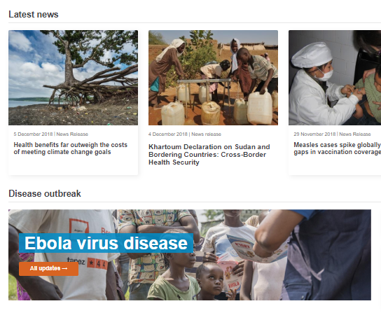
The Dataset
Dataset taken from kaggle.com
Generated from the World Health Organization website
193 countries, 21 Features, between 2000 – 2015
Features: Economical, Physical, Diseases etc.
Some incomplete points, required more cleaning than normal

Slide 5
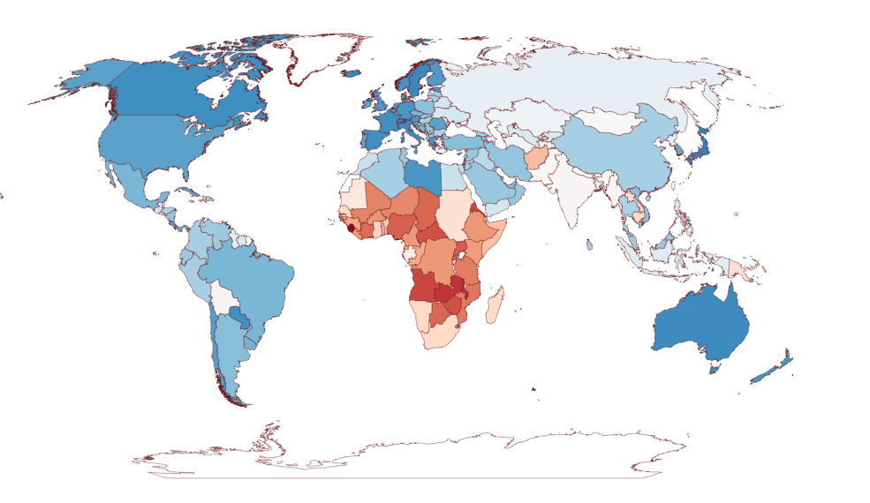

Life Expectancy in the year 2000
in years

Slide 6
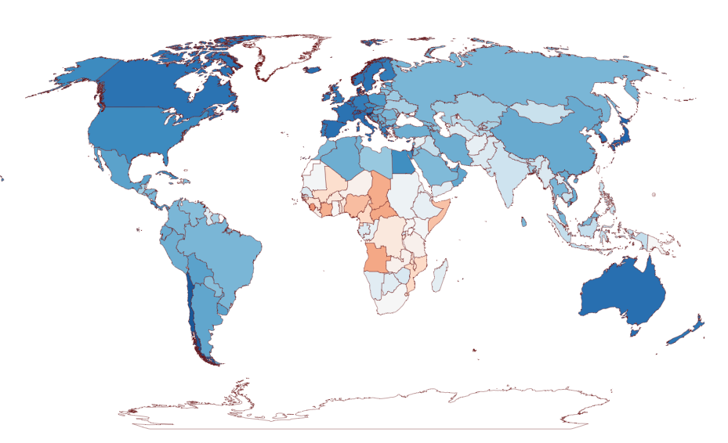
Life Expectancy in the year 2015
in years

Slide 7

Motivation
Big difference between the countries
What features play a major role in this difference?
Factors that are most related to life exp.
Overall increasing life expectancy from 2000 to 2015
How can we keep it up?
How can the lower life exp. countries do better?
Suggestions / conclusions to paint the whole map blue

